Slide 1


BAN6800: Business Analytics Capstone
Module 4 Assignment: Business Analytics Model
Name:Kingsley Osarobo Edionwe
Learner ID:157398

Slide 2


GITHUB URL
        https://github.com/Kingslyno/Module-4-Capstone.git
Notes:
Done

Slide 3
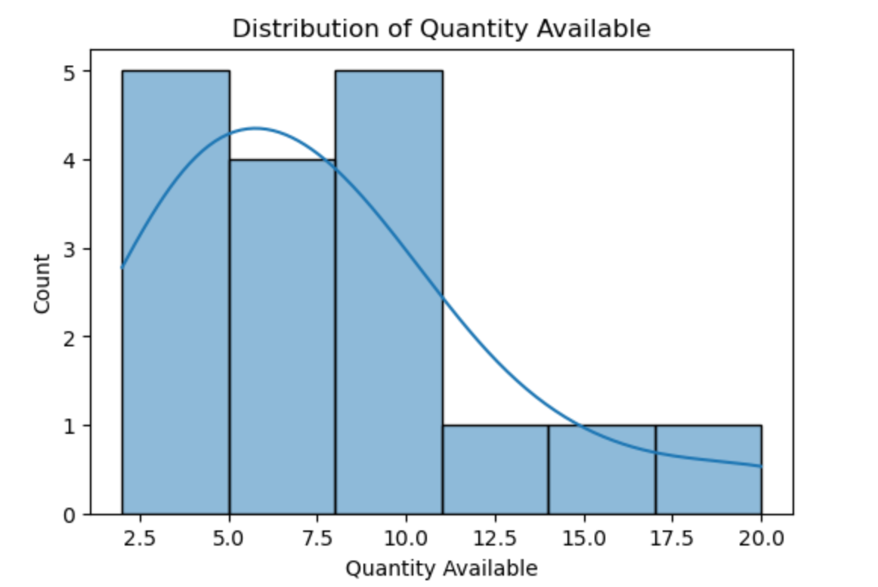
Model Result 1
Notes:
Done

Slide 4
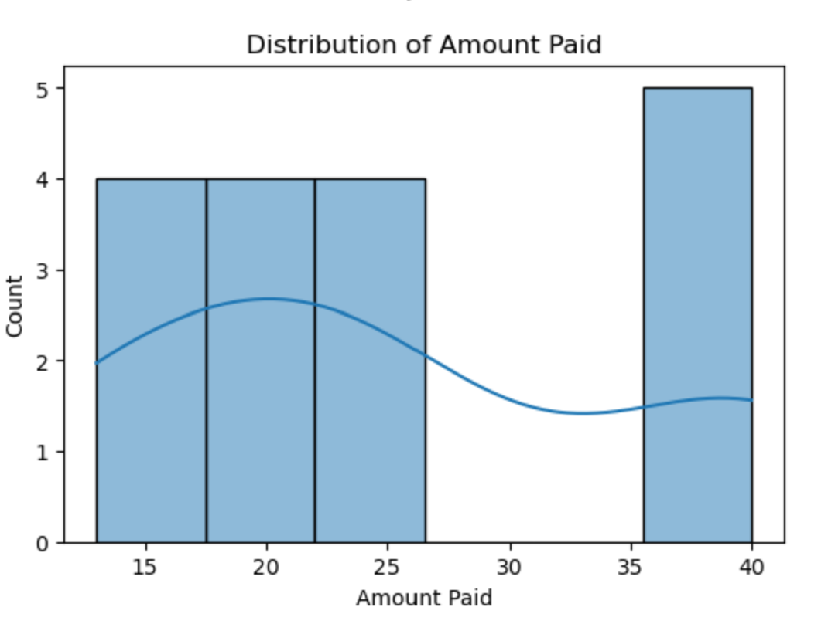
Model Result 2
Notes:
Done

Slide 5
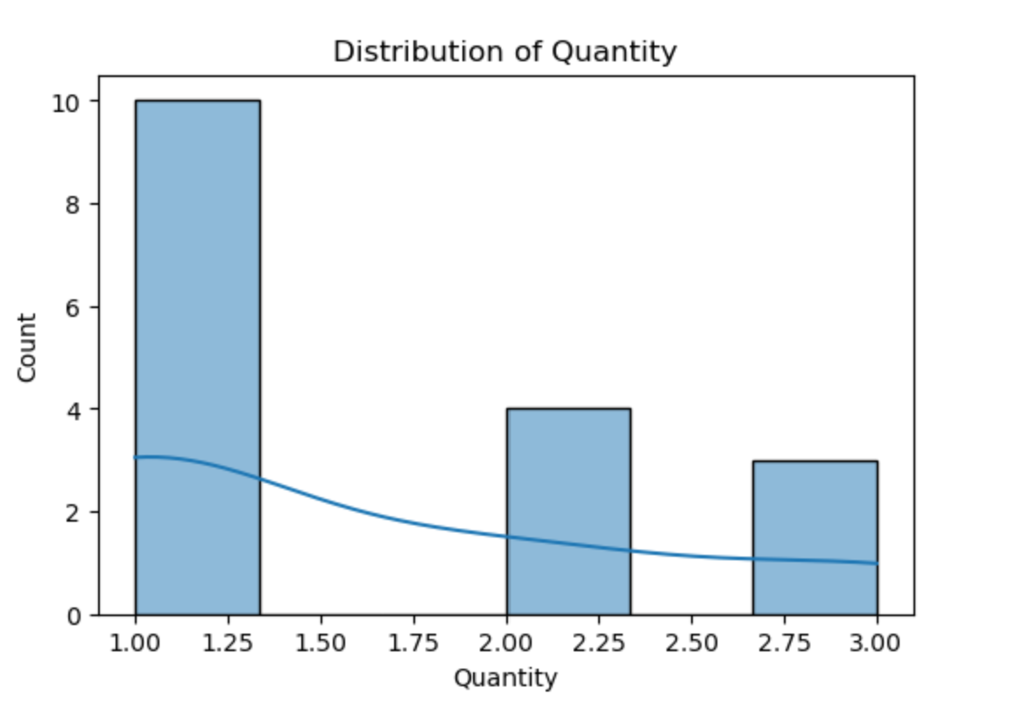
Model Result 3
Notes:
Done

Slide 6
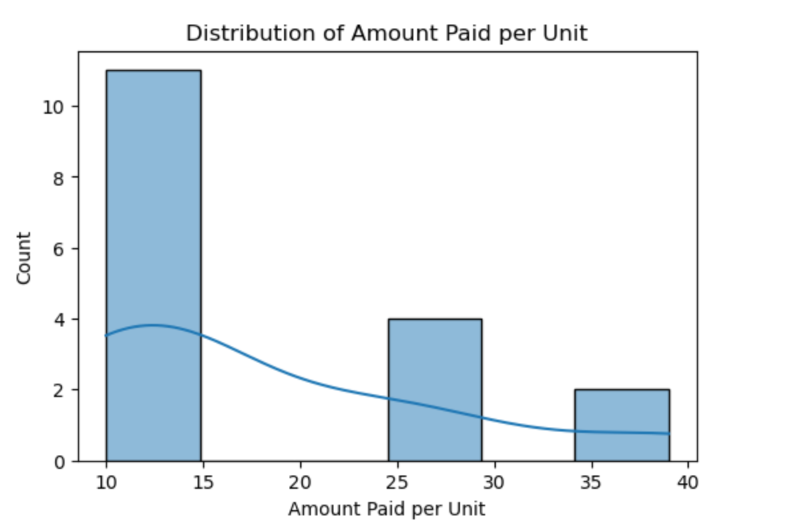
Model Result 4
Notes:
Done

Slide 7
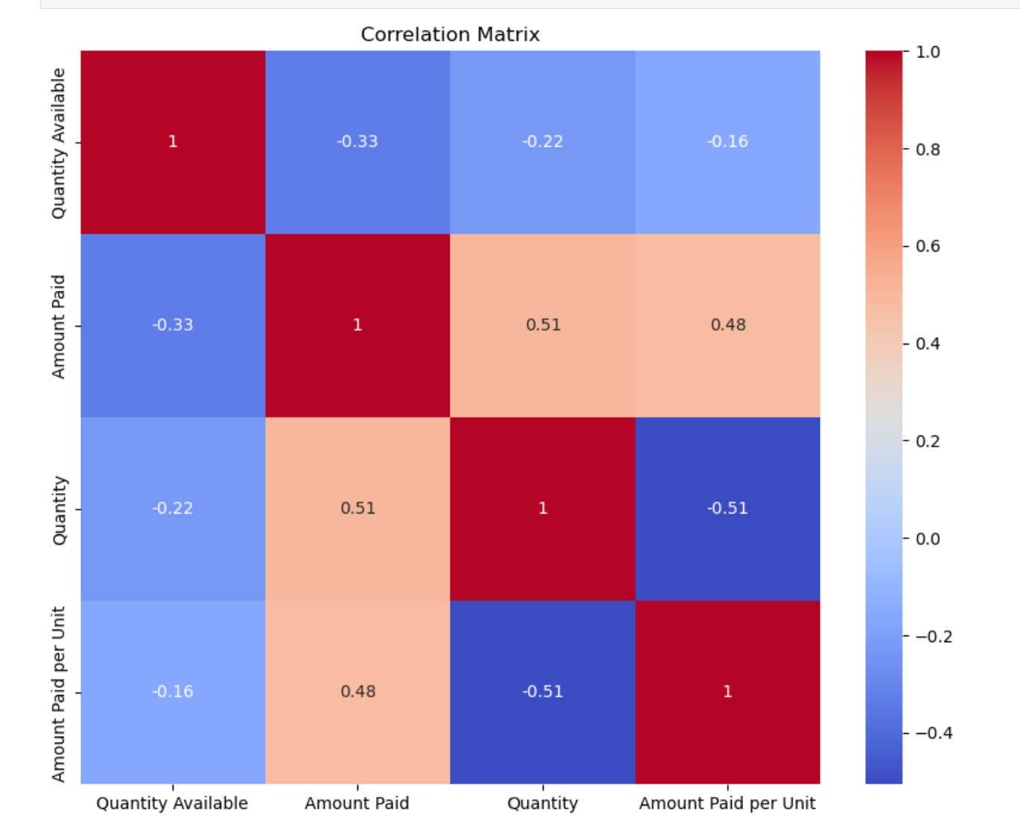
Correlation
Notes:
Done

Slide 8
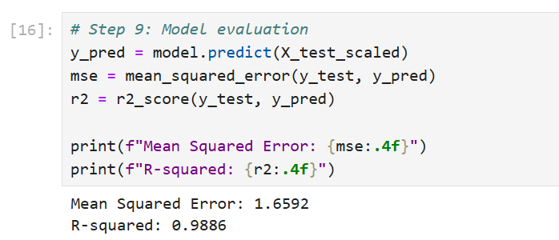
Model Evaluation

Slide 9
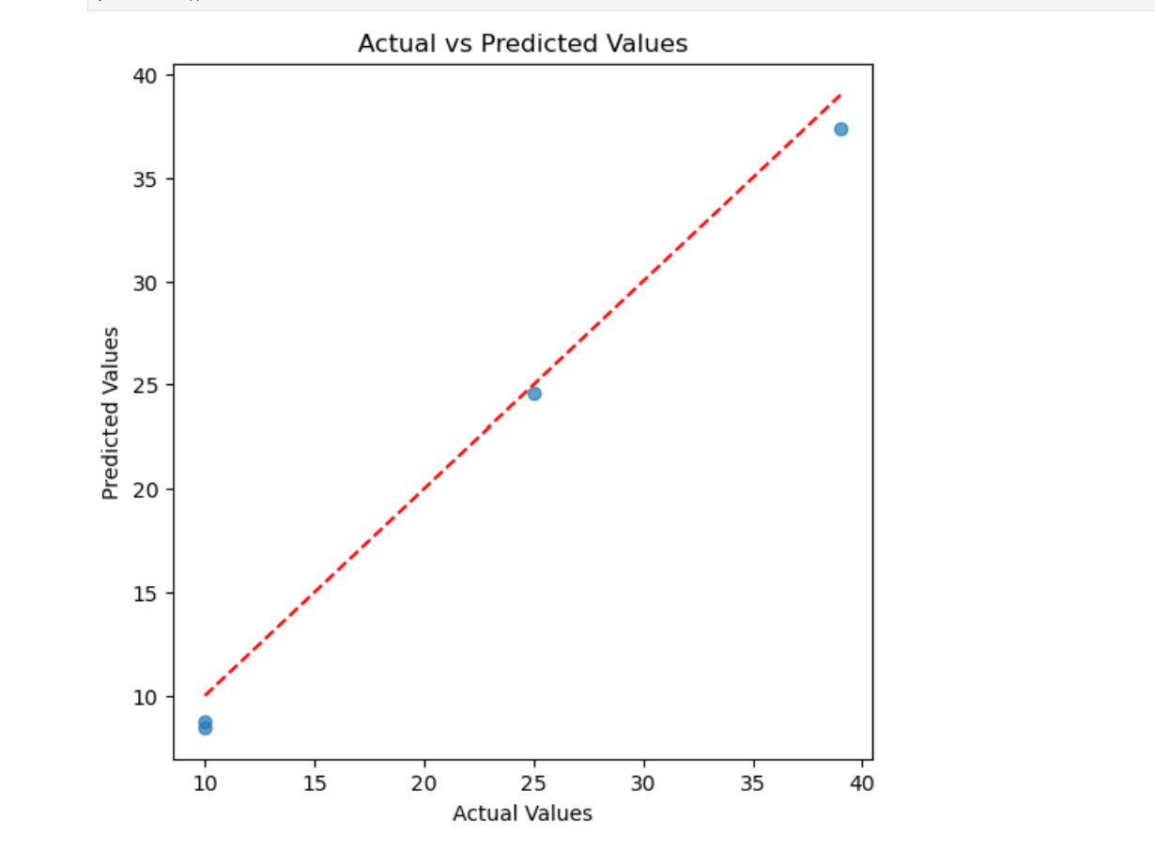
Model Prediction
Notes:
Done

Slide 10


Thank you!

